Slide 1
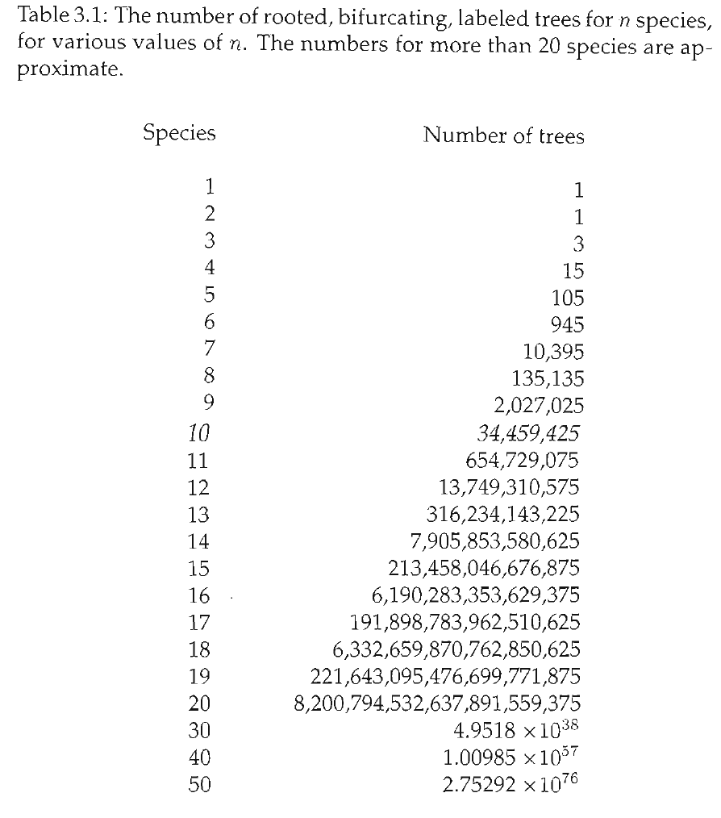
Practical considerations
How do you find the most parsimonious tree?
One way: 1. Try every possible tree.
2. For each tree, count min # of steps 3. Choose the tree with the fewest # steps
Too many trees.

Slide 2
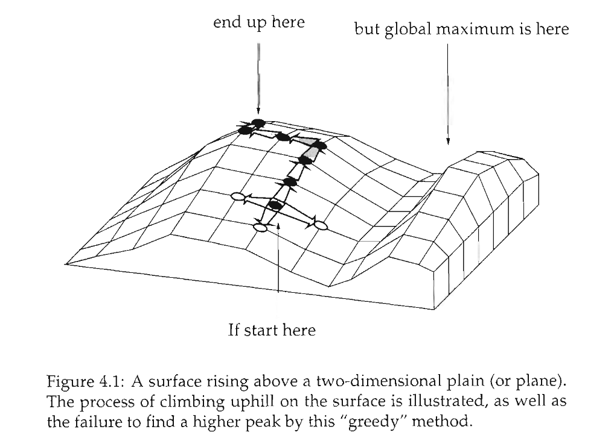
Heuristic searches
Don’t try every tree.
“Hill-climbing algorithm”
Wander around under certain rules. Hope that what you eventually stop at is the best.
Not guaranteed to find the best tree.
Can be improved by lots of random starting points.
(Not necessary for parsimony, exact algorithmic solution possible with a “branch and bound” search)
Better trees
“Tree space” Each point on the grid is a possible tree.
Trees next to each other are “1 step away” via
algorithmic manipulation
Start at a random tree.
Try all trees that are nearby, choose the one that’s best
Keep doing that til you can’t make the tree any better.

Slide 3
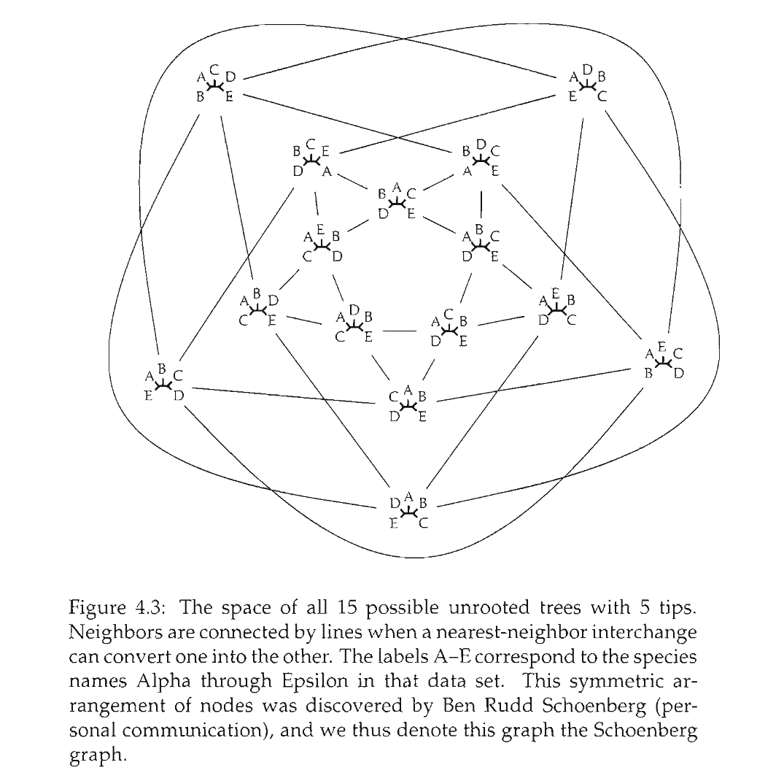

Slide 4
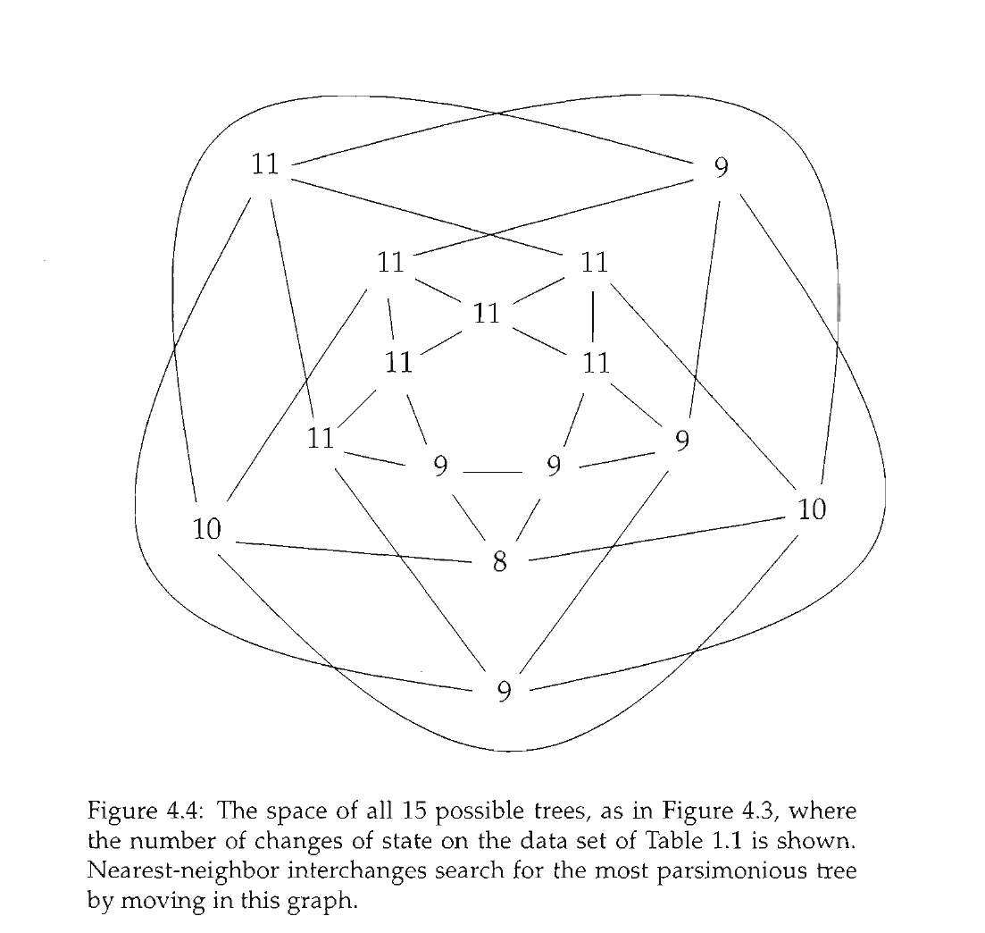

Slide 5
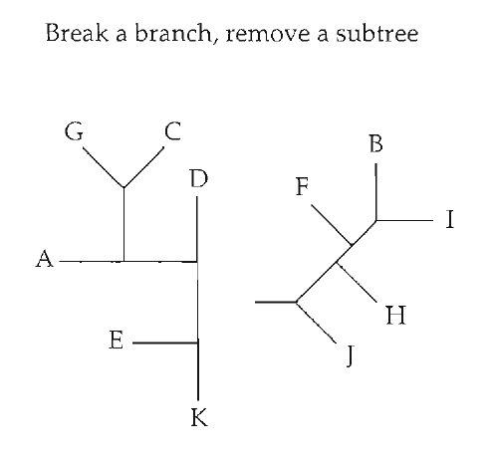
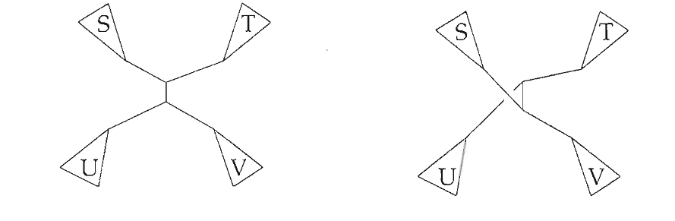
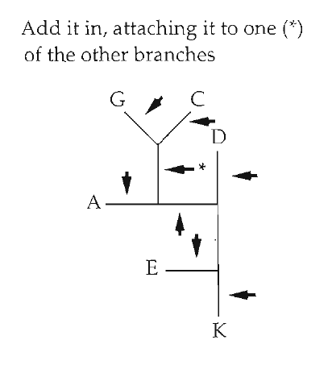
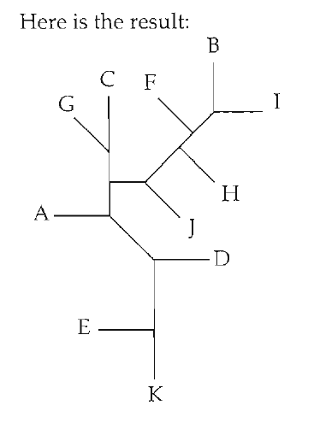
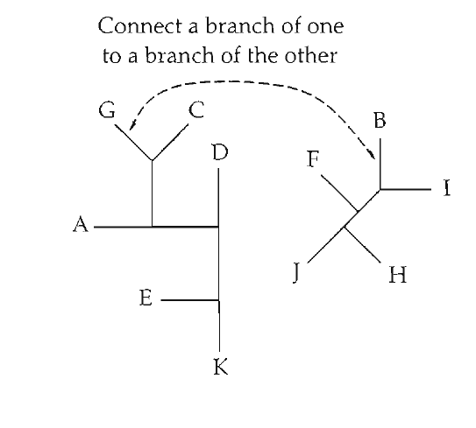
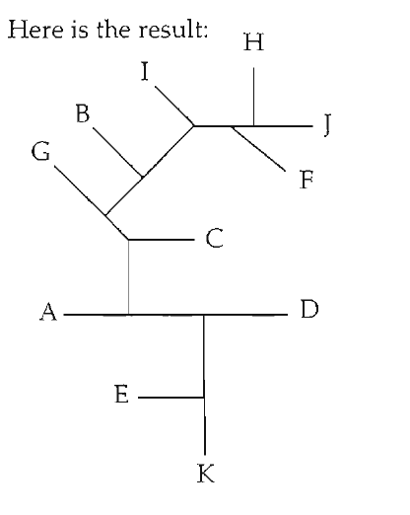
Tree space "moves"
Nearest Neighbor Interchange (NNI)
Tree bisection and reconnection (TBR)
Subtree pruning and regrafting (SPR)

Slide 6
Distance between tree spaces changes depending on which moves you use
NNI fastest, least computationally intensive, but the largest distances between trees
TBR slowest, most computationally intensive, but shortest distances between trees
SPR intermediate

Slide 7
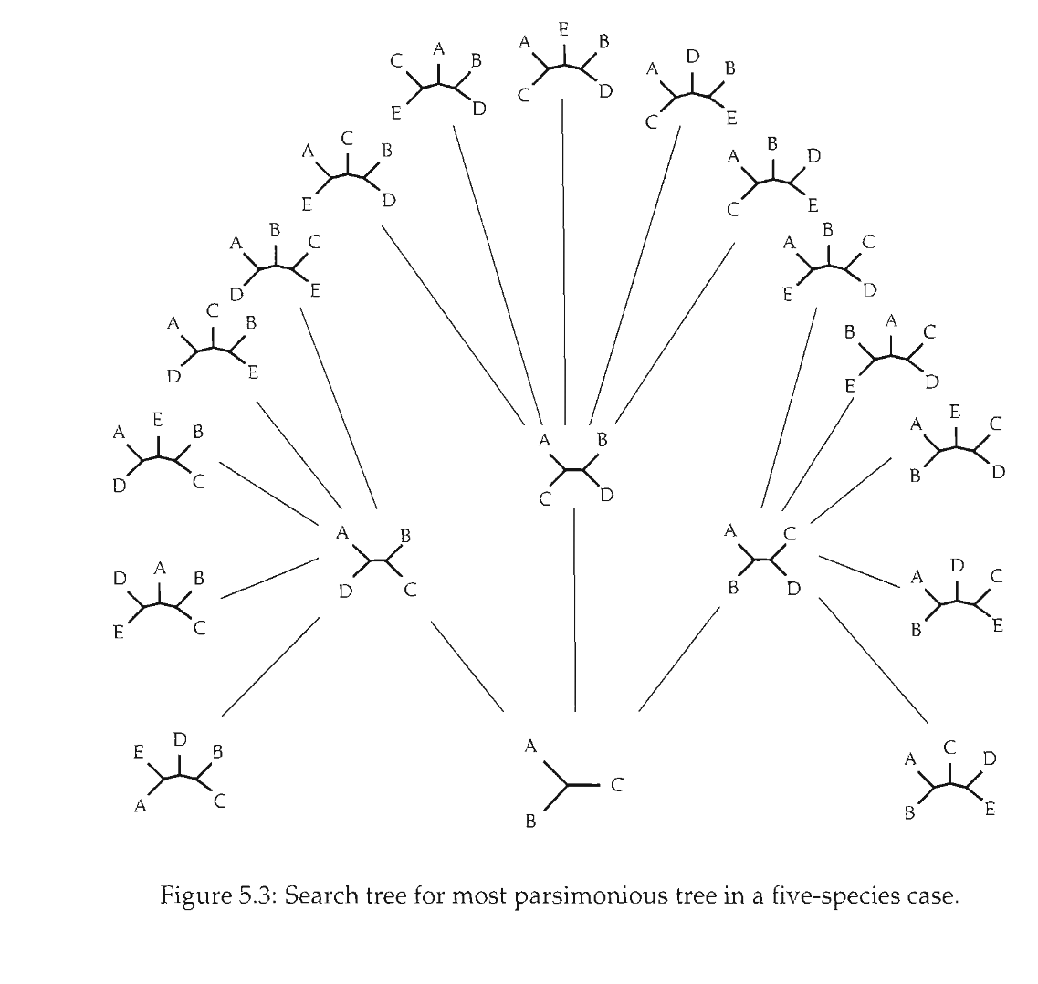
Branch and bound

Slide 8
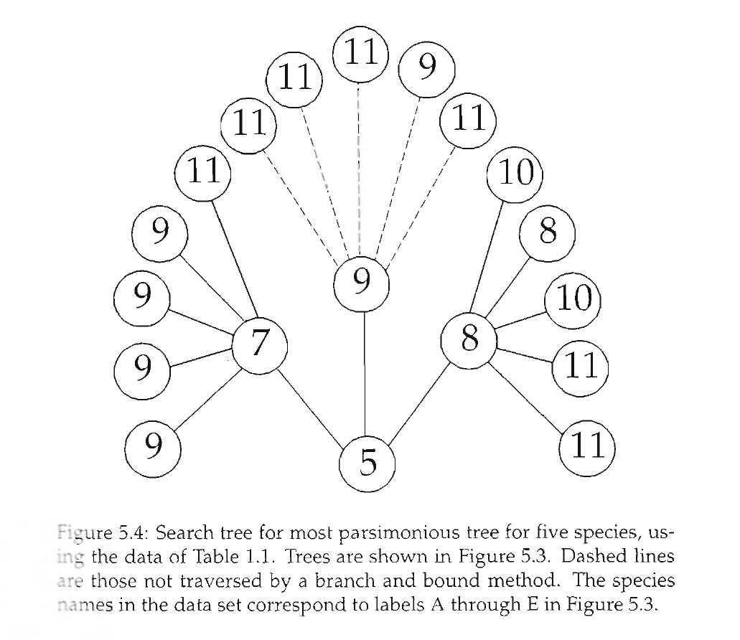
Branch and bound

Slide 9
Felsenstein & the birth of statistical phylogenetics
How do we think about probabilities & trees?

Slide 10
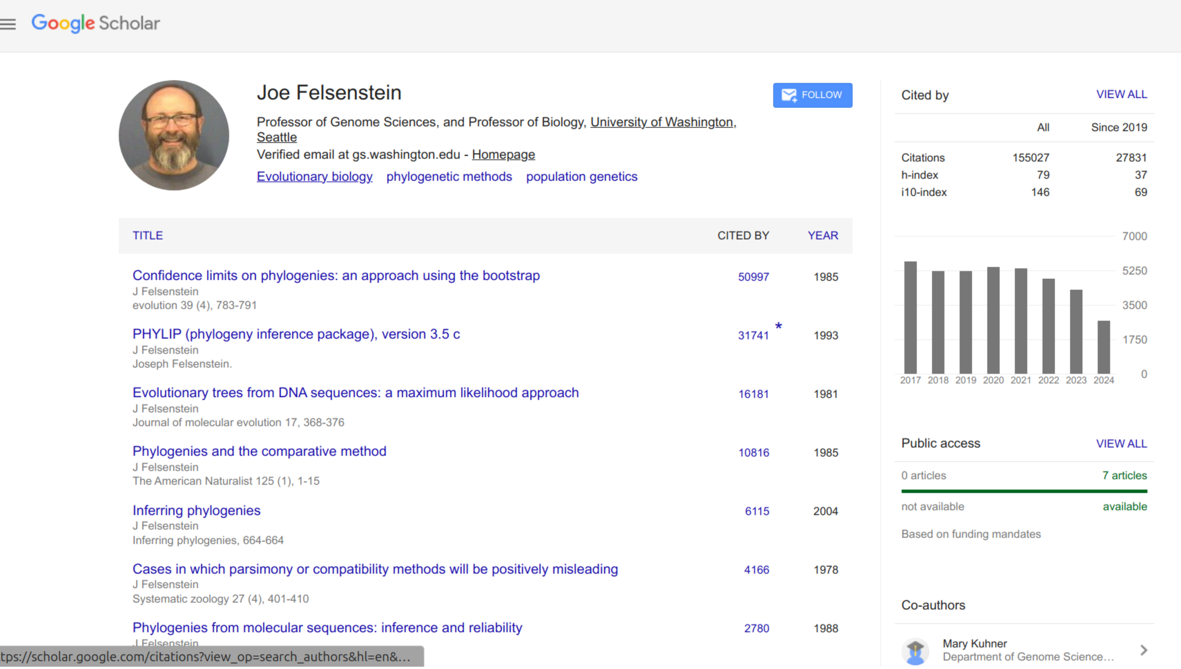

Slide 11
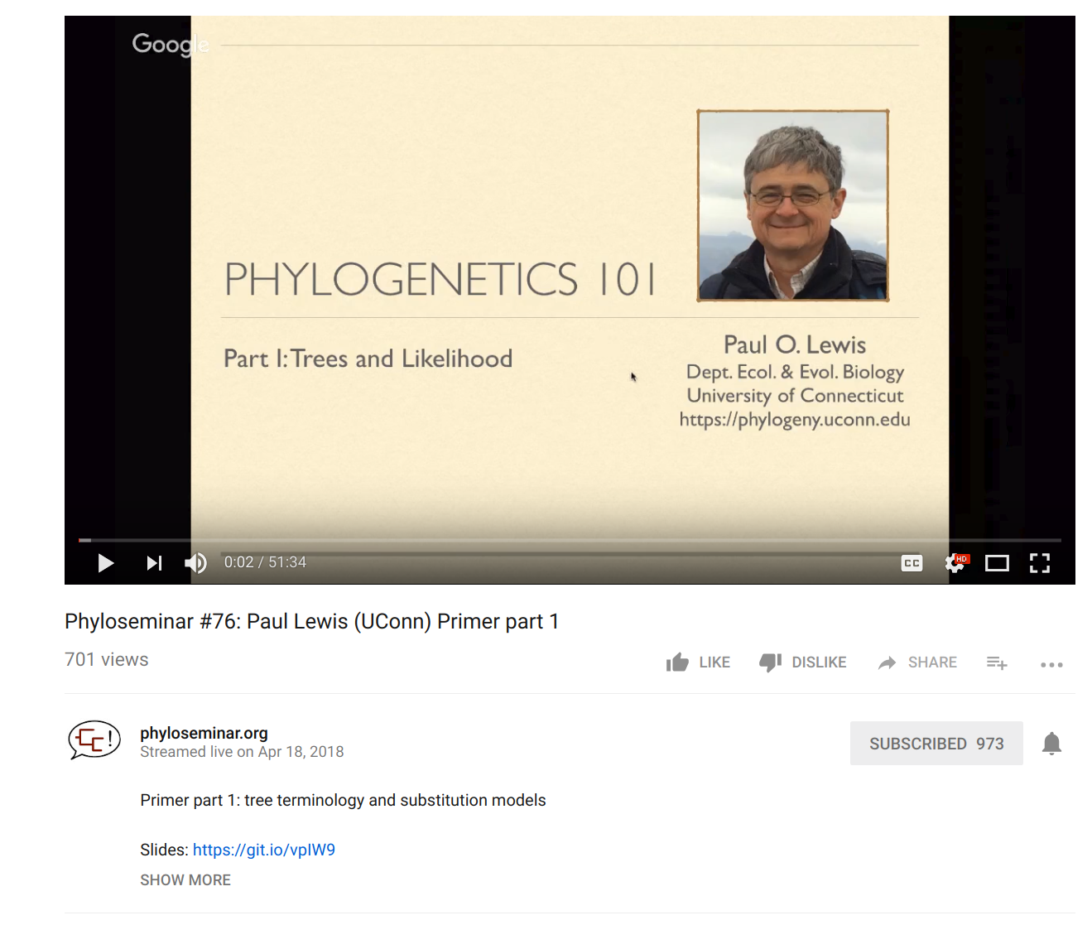
Full disclaimer: I'm borrowing A LOT of this material from Paul Lewis (Uconn) (Check out his teaching materials!)

Slide 12
If two DNA sequences are unrelated, what % of bases (aligned sites) do you expect to be identical?
A. 50%
B. 25%
C. 0%
D. I need more information

Slide 13
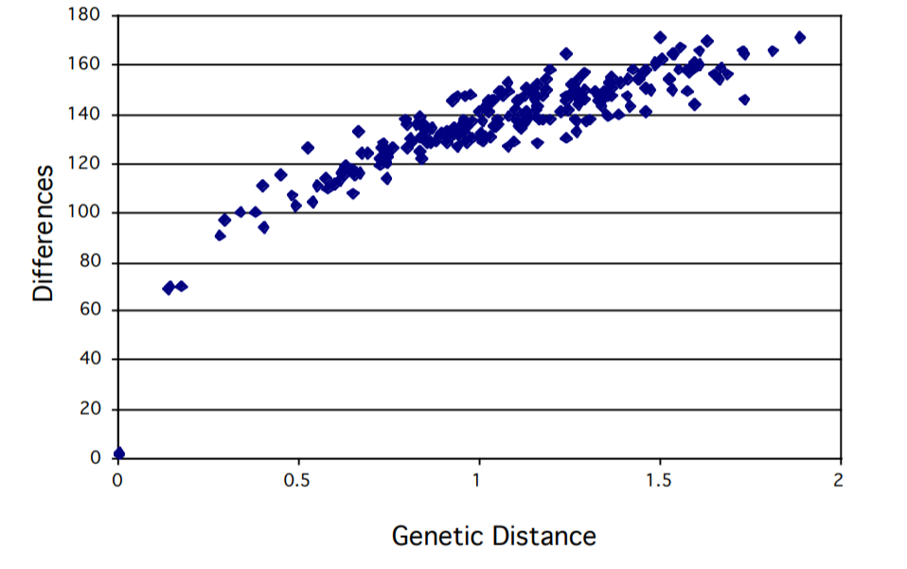
Why do we need statistics?

Slide 14
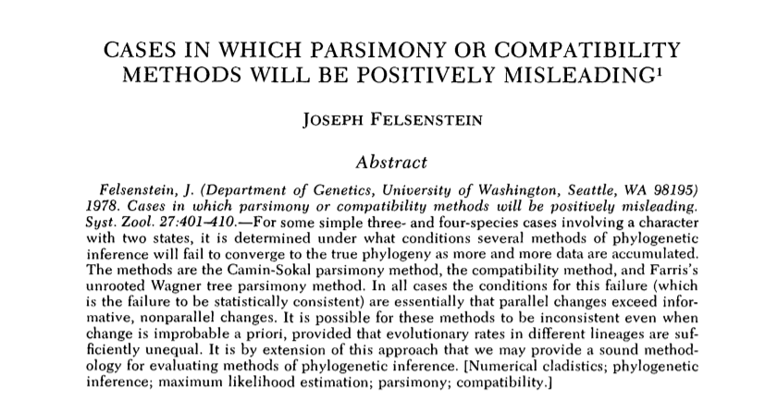
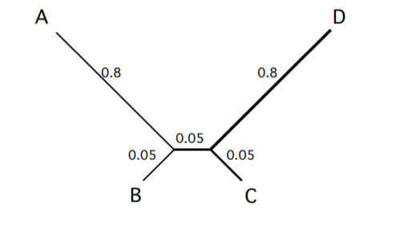
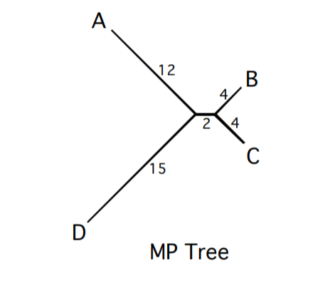
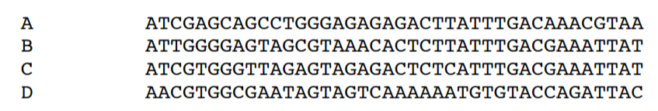
"Long-branch attraction"

Slide 15
P( | )
P( | )
read as: The probability of this alignment (the data) GIVEN or CONDITIONAL UPON this being the true tree.

Slide 16

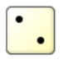
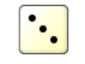
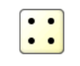
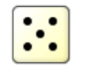
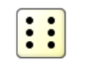
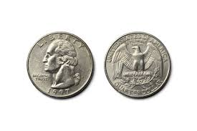
How do we treat trees probabilistically?
Let’s simplify to a binary (0/1) trait
(rather than 4 DNA bases)
If these come up, a substitution occurs
If these come up, no substitution occured
If a substitution occurs, choose which substitution occurs by a coin flip.

Slide 17
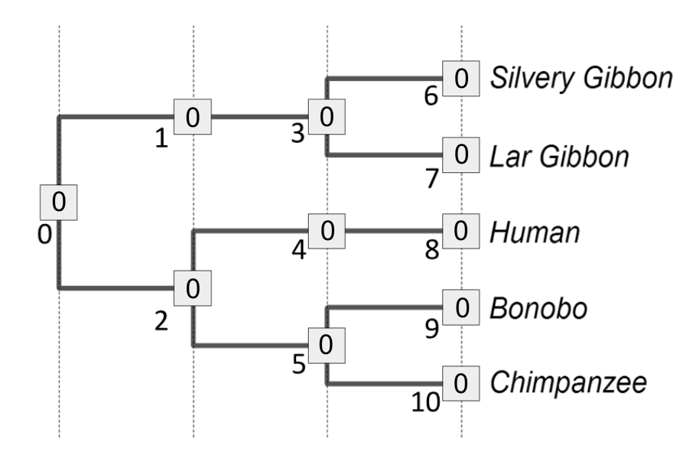

Slide 18
0

Slide 19
0
0

Slide 20
0
0
0

Slide 21
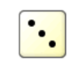
0
0
0
0
0

Slide 22
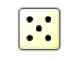
0
0
0
0
0
0

Slide 23
0
0
0
0
0
0
1

Slide 24

0
0
0
0
0
0
0
1

Slide 25
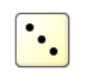
0
0
0
0
0
0
0
1
1
1

Slide 26
0
0
0
0
0
0
0
0
1
1
1

Slide 27
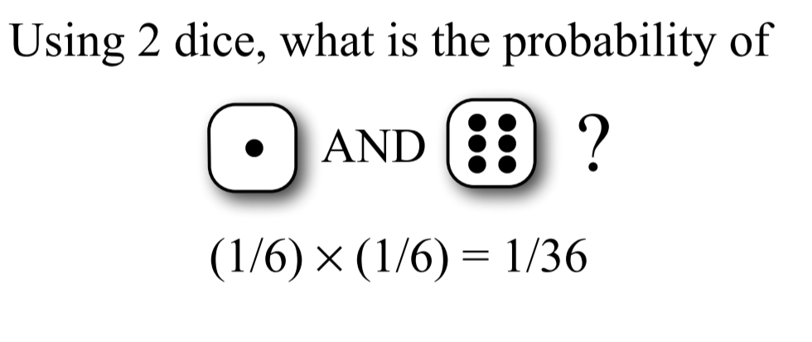
Combining probabilities: The AND rule
If two independent events occur, MULTIPLY their individual probabilities to get the full probability of an event. Each roll of the dice (and each flip of the coin) is independent.

Slide 28
Combining probabilities: The AND rule in phylogenetics
0
0
0
0
0
0
0
0
1
1
1
L(T₁ | D, N_{i})=P(D, N_{i}|T₁)* = (4/6)⁹ x [(2/6)(1/2)]¹=0.0043
Read as: The likelihood of Tree 1 given the data at the tips (D) and nodes (N_{i}) is equal to the probability of the data and node states given Tree 1 is true. (We can’t ask “is Tree 1 true” so simply, so we use the word Likelihood instead)

Slide 29
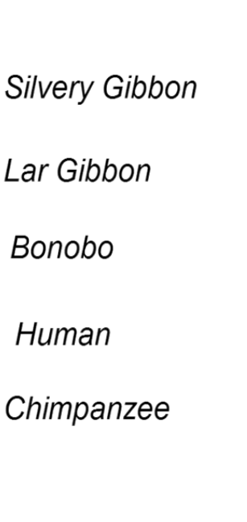
Combining probabilities: The AND rule in phylogenetics
0
0
0
0
0
0
1
0
0
0
1
Likelihood(D, N_{j}|T₂)* = (4/6)⁸ x [(2/6)(1/2)]²=0.0011

Slide 30
0
0
0
1
1

Slide 31
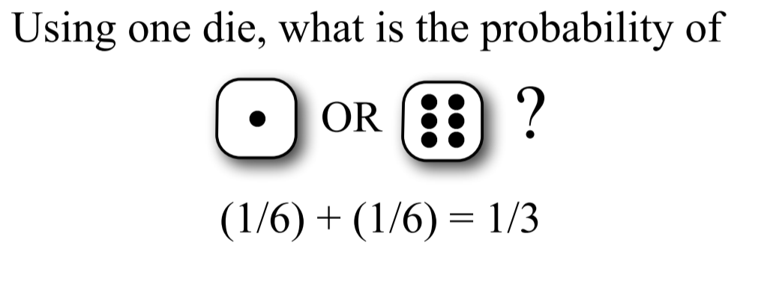
Combining probabilities: The OR rule
Two mutually exclusive probabilities should be ADDED together to get the total probability of the two events

Slide 32
Combining probabilities: The OR rule in phylogenetics
What’s the likelihood
of the data under “Tree₁”
0
0
1
0
1
1
0
0
1
0
1
Likelihood (D, N_{k}|T₁)=(4/6)¹ x [(2/6)(1/2)]⁹=0.000000066
This is a possible outcome under Tree₁, but not especially likely!

Slide 33
Combining probabilities: The OR rule in phylogenetics
What’s the likelihood
of the data under “Tree₁”
0
1
1
0
1
0
0
1
1
1
1
Likelihood (D, N_{k}|T₁) = (4/6)⁷ x [(2/6)(1/2)]³=0.00027
This is also a possible outcome, a little bit more likely!

Slide 34
There are 2⁶ = 64 possible node assignments for Tree₁. We could calculate the likelihood of each one, then ________ them together, to get the total Likelihood(Tree₁ | Data). Now, like parsimony, you can do either a heuristic or exhaustive search for the tree with the maximum likelihood)
0
0
0
1
1

Slide 35
We used discrete time units. Biology will want continuous time

Slide 36
Continuous-Time Markov Models
Markov assumption = probability of change depends only on current state, not how long it has been in that state

Slide 37
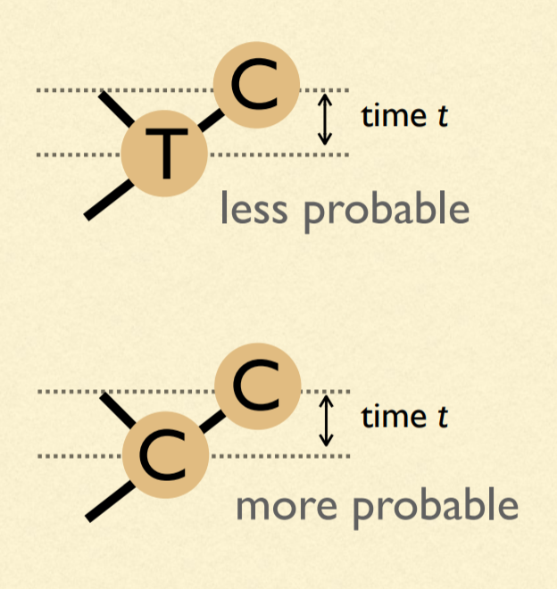
Our model of change depends on time: We must estimate branch lengths
Units of branch length will be expected number of substitutions per site
(= rate of substitions x time)

Slide 38
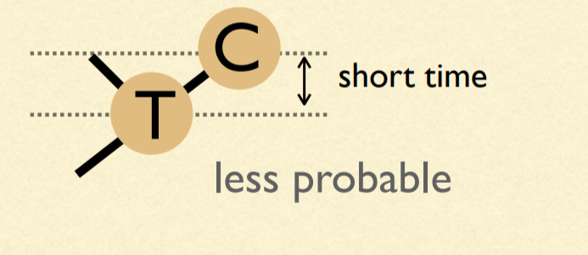
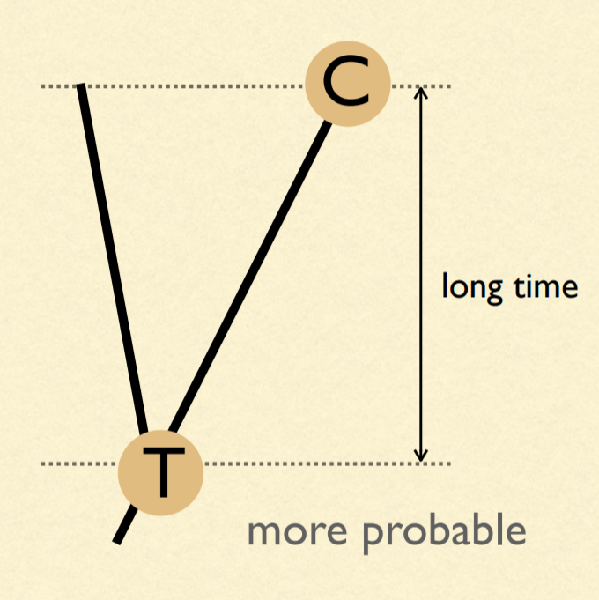
Probabilities are dependent on time

Slide 39
μ = 4β
A
β
β
β
β
A
T
G
C

Slide 40
A (very) simple phylogeny...
time
A
A
P_{AA} =
Probability nothing happened +
Probability something happened, but that the last thing that happened ended in an A

Slide 41
A (very) simple phylogeny...
time
A
A
P_{AA} = (e^{-μt} ) + (1 - e^{-μt})(1/4)
Probability something doesn't happen
Probability at least one thing happens
Probability that the last thing that happened ends in an A

Slide 42
A (very) simple phylogeny...
time
A
G
P_{AG} = (1 - e^{-μt})(1/4)
Probability at least one thing happens
Probability that the last thing that happened ends in an G

Slide 43
A (very) simple phylogeny...
time
A
C
P_{AC} = (1 - e^{-μt})(1/4)
Probability at least one thing happens
Probability that the last thing that happened ends in an C

Slide 44
A (very) simple phylogeny...
time
A
T
P_{AT} = (1 - e^{-μt})(1/4)
Probability at least one thing happens
Probability that the last thing that happened ends in an T

Slide 45
One last bit...substitutions vs. "events"
ν = (3/4)μt = 3βt
4ν/3 = μt
Only 3 out of 4 events results in a substitution. Thus, we can define the substitution rate ν.

Slide 46
P_{AA} = (e^{-μt} ) + (1 - e^{-μt})(1/4)
P_{AG} = (1 - e^{-μt})(1/4)
P_{AC} = (1 - e^{-μt})(1/4)
P_{AT} = (1 - e^{-μt})(1/4)

Slide 47
P_{AA} = (1/4) + (3/4)(e^{-4ν/3} )
P_{AG} = (1/4) - (1/4)(e^{-4ν/3})
P_{AC} = (1/4) - (1/4)(e^{-4ν/3})
P_{AT} = (1/4) - (1/4)(e^{-4ν/3})
Sanity check: Do they all add to 1?

Slide 48
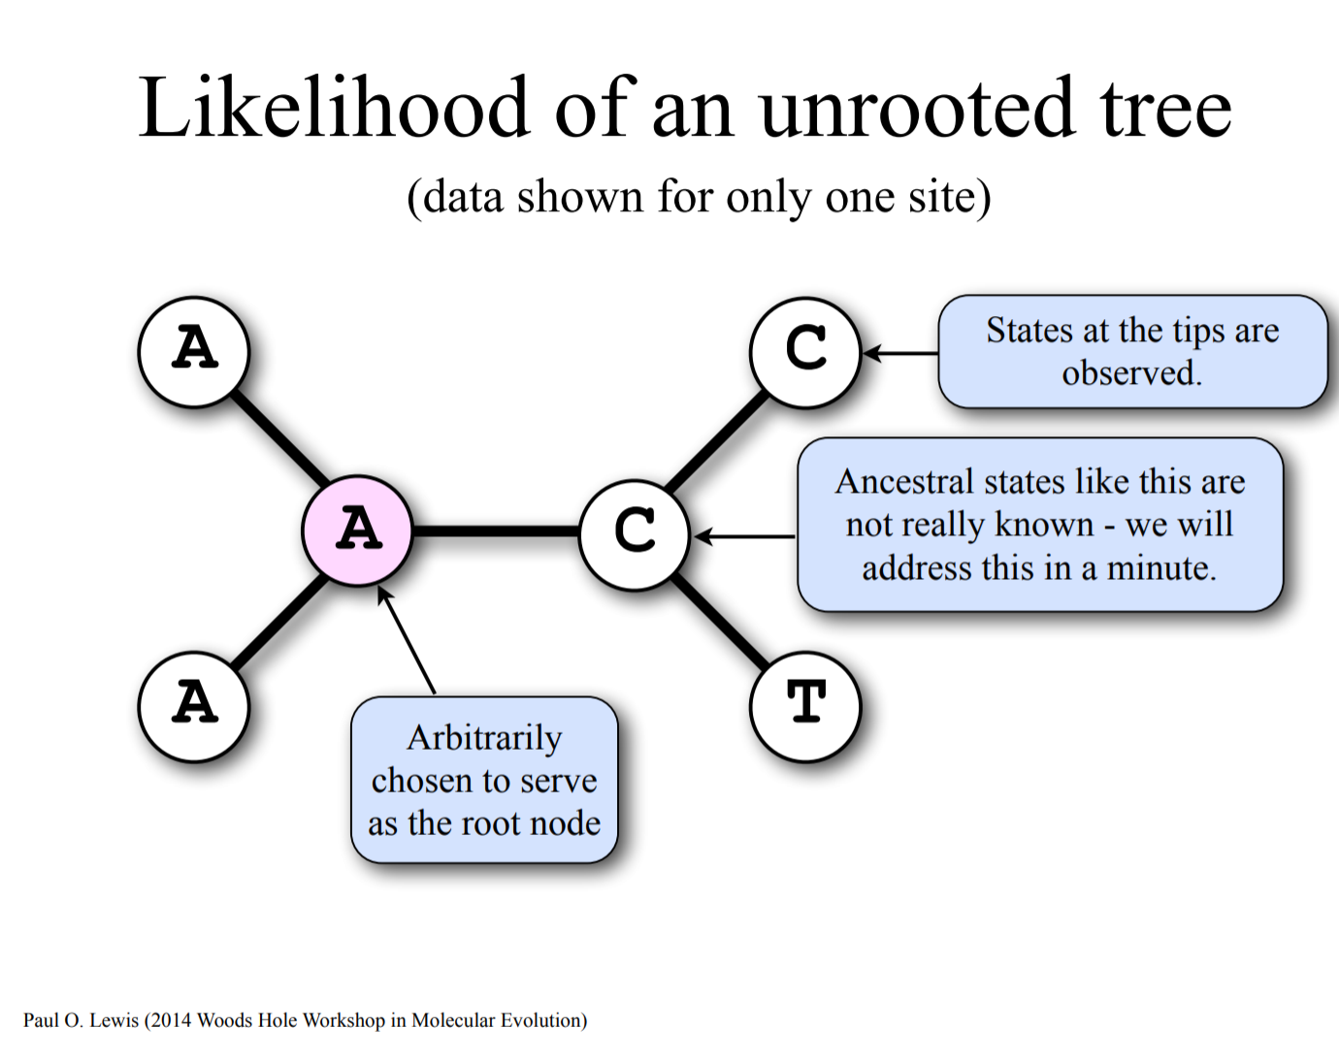

Slide 49
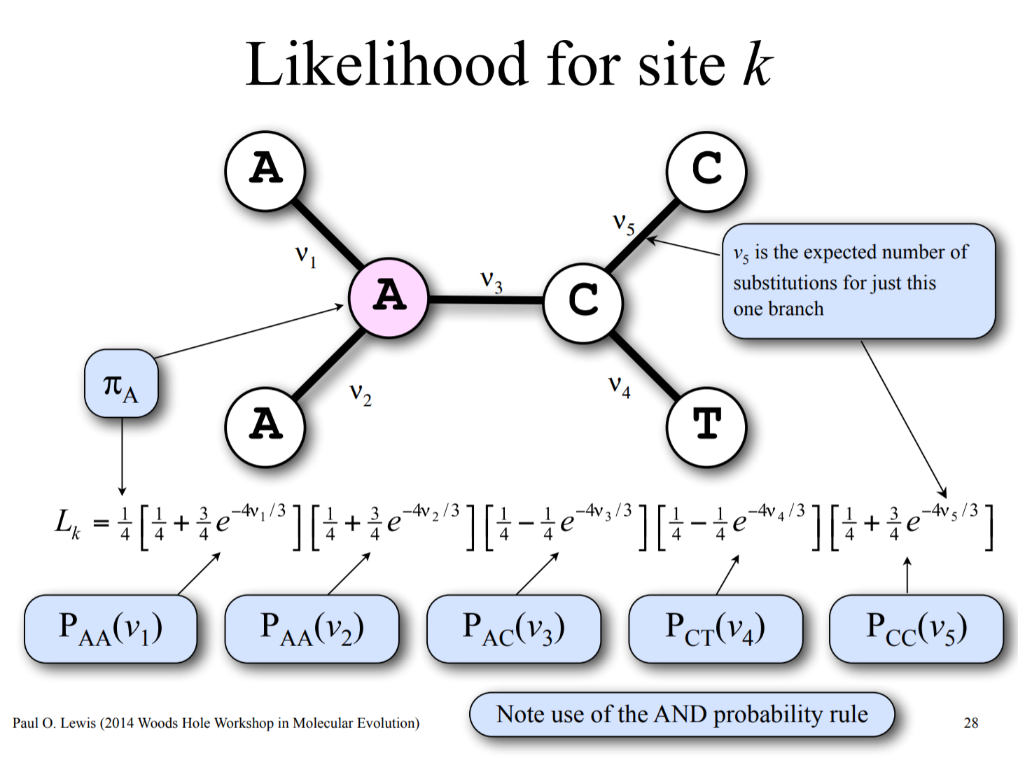

Slide 50
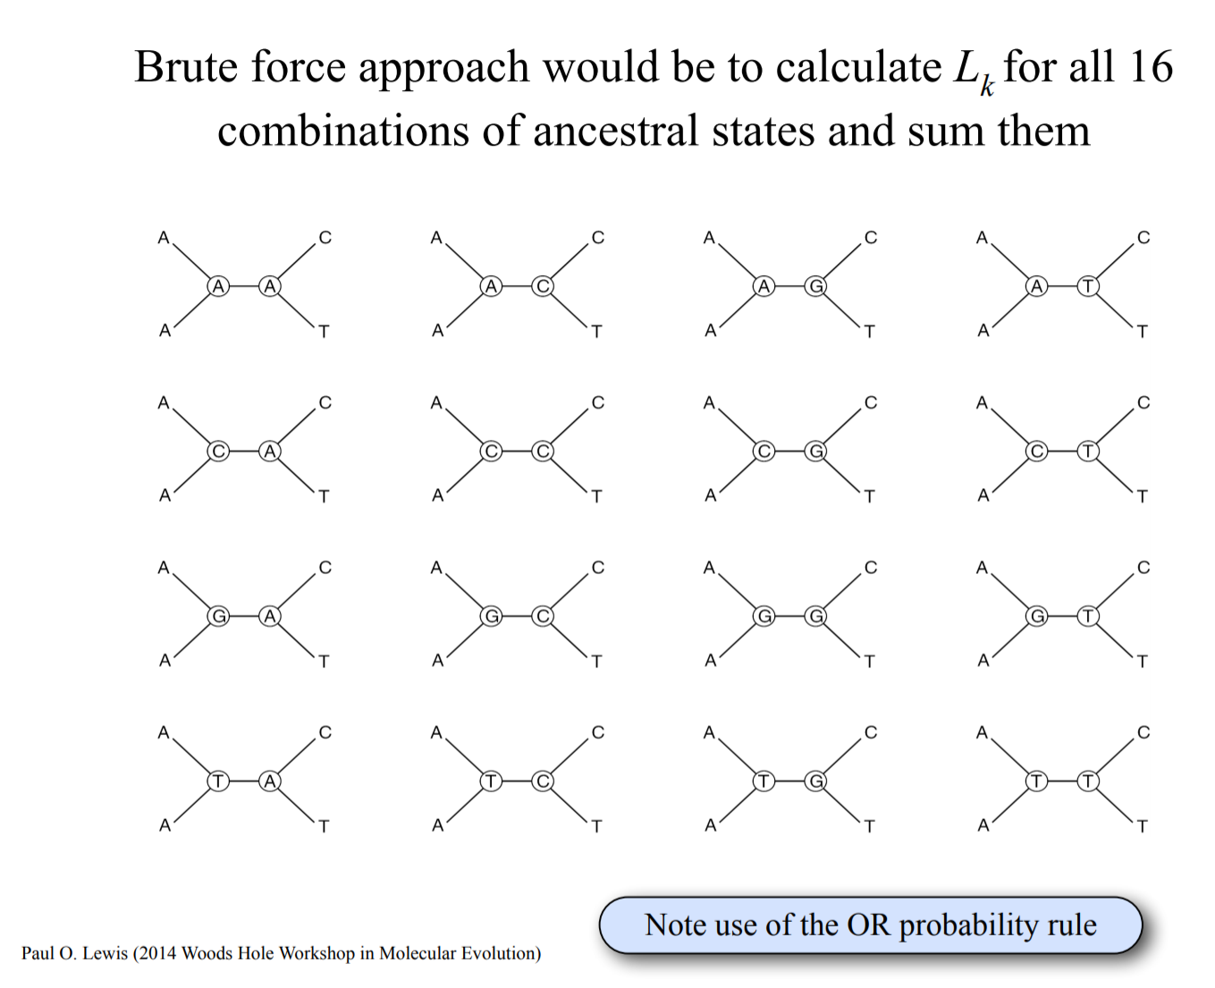

Slide 51
Pruning algorithm

Slide 52
Pruning algorithm

Slide 53
Pruning algorithm

Slide 54
Pruning algorithm

Slide 55
Pruning algorithm

Slide 56
Pruning algorithm

Slide 57
Pruning algorithm

Slide 58
Pruning algorithm

Slide 59
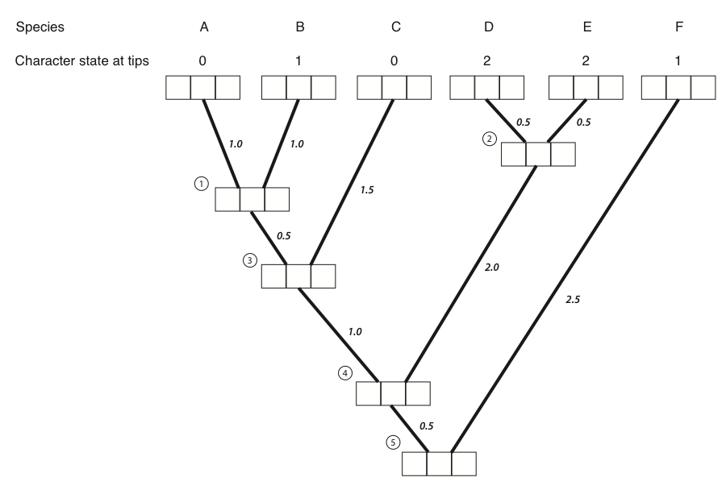
1 0 0
0 1 0
1 0 0
0 0 1
0 0 1
0 0 1

Slide 60
1 0 0
0 1 0
1 0 0
0 0 1
0 0 1
0 0 1
0.12 0.12 0.1

Slide 61
